Slide 1
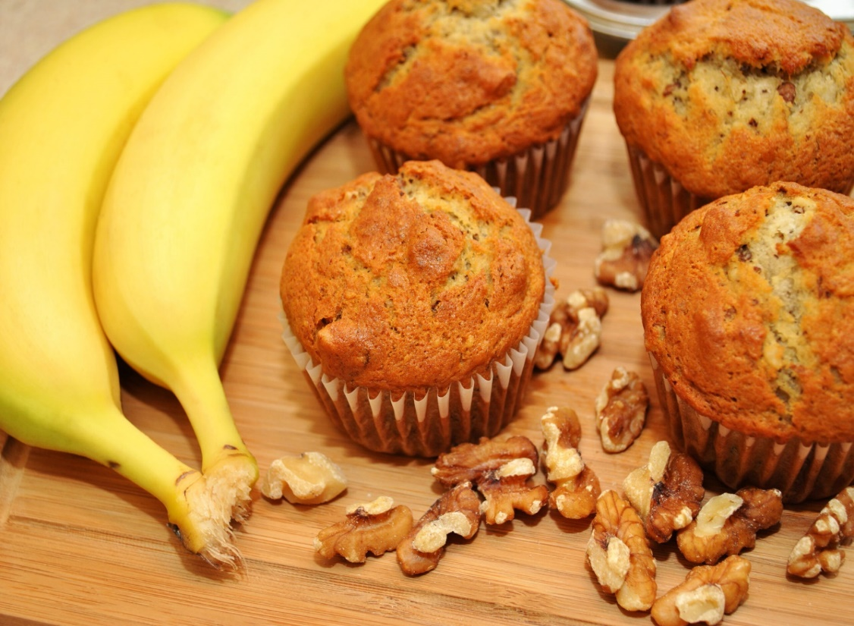
Mercy’s Sweet N’ Fresh
Human Resource Implementation Plan

Slide 2
Mercy’s Sweet N’ Fresh
Executive Summary
Mercy’s Sweet N’ Fresh is a homemade pre-order baked product. We offer four types: chocolate cake, Banana Muffins, Puto Cheese, and Kutchinta. Products are naturally made from flour, sugar, milk, eggs, and other ingredients with no added preservatives. This product was usually served as a snack with coffee to every Filipino back home in the Philippines. It is a pre-order service here in Terrace, so customers can place their order a couple of days ahead of time they need. We deliver customer’s orders at their convenient place.

Slide 3
Job Description
Baker
Bakers can bake several kinds of baked and steamed products, such as chocolate cake, banana muffins, puto cheese, and kutchinta.
Able to measure and mix ingredients properly, which could provide good product results and satisfy the customers.
Responsible for taking customers' orders, supplying them at the right time, and delivering without delay.
Recruitment Strategy
Mercy’s Sweet N’ Fresh recruitment method involves social media posting and being referred by a friend. A person interested in baking is also welcome to apply and get hired at a minimum wage rate.

Slide 4
Compensation
The Baker shall receive an hourly wage in cash, with no tax deduction since we are a home-based business. He/she can be incentivized for a minimum of 10 orders. He/she will have free meals while on duty since we are doing our job at home.
Training
Training will start on the first day after the employee is hired to become Mercy’s baker. It is a learning process and measures the ingredients because baking is so sensitive that it needs more attention when doing it.
Qualification
Know how to bake, create new recipes to offer, deliver the finished product to customers, and be open-minded.
Should communicate with other people well and be able to promote the products to get additional customers and generate sales.
Has the heart of a baking lover because a person who loves baking is easily trained and can easily understand the process to avoid any mistakes that can cause the order to be delayed.
APPLY NOW!

