Slide 1
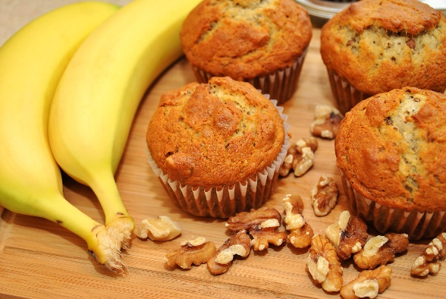
Operation Plan
Goals
01
To provide the customer’s satisfaction and a good quality of products and convenience.
To expand the business from home-based to physical stores in the market after three years.
02
Objectives
Collaborate with Filipino group community events and implement a successful social media marketing strategy to promote the product.
Timeline
03
March – April 2024—Planning and decision-making. Prepare all materials and utensils needed, including securing the equipment for making samples to post on social media for promotion.
May 2024 - Start the business, invite more customers, and generate sales.
04
Equipment & Other Materials to Served.
Oven: For Banana Muffin & Chocolate cakes
Steamer: For Puto Cheese & Kutchinta
Packaging: Aluminum Foil & Aluminum tray for the finished products.
Electric Mixer: For the chocolate mixture.

